Slide 1
CUSTOMER-FOCUSED E-COMMERCE SITE WITH AI BOT
A PROJECT REPORT
SUBMITTED BY
G. VIGNESH THANGAM (192212284)
N. HARINI (192212232)
UNDER THE GUIDANCE OF
DR R DHANALAKSHMI
hh

Slide 2
PROBLEM STATEMENT:
Project: Customer-Focused E-Commerce Site with AI Bot
PROBLEM STATEMENT:As e-commerce continues to evolve, businesses face increasing competition and rising customer expectations for personalized shopping experiences. Customers often struggle to find products that meet their needs amidst vast selections, and delays in customer support can lead to dissatisfaction and cart abandonment. Traditional e-commerce sites may lack the necessary tools to provide real-time assistance and tailored recommendations, impacting overall customer engagement and sales.
TASKS:
User-friendly interface for browsing and purchasing products.
AI bot capable of understanding customer inquiries and providing real-time assistance.
Personalized product recommendations based on user behavior and preferences.
Secure payment processing and order tracking capabilities.
Customer account management features for easy order history access and preferences.
Analytics dashboard for administrators to monitor sales trends and customer interactions.
Feedback mechanism for customers to rate their experience with the AI bot and the platform.
OUTCOME: The outcome of this project is to develop a Customer-Focused E-Commerce Site with an AI Bot that enhances the shopping experience by providing personalized product recommendations and instant support. The AI bot will utilize natural language processing and machine learning algorithms to interact with customers, answer their queries, and guide them through the purchasing process. By integrating intelligent automation into the e-commerce platform, the site aims to improve customer satisfaction, reduce response times, and drive conversions.

Slide 3
AIM::
This project aims to develop a customer-focused e-commerce platform that leverages Artificial Intelligence (AI) to significantly enhance the online shopping experience.
By integrating AI-powered features, the platform will deliver personalized product recommendations based on a customer's browsing history, purchase patterns, and preferences, increasing cross-selling and upselling opportunities.
The AI chatbot will provide real-time, instant customer support, answering queries in plain language and reducing wait times.
Additionally, the platform will guide customers through the purchasing process by offering product details, comparisons, and reviews, improving decision-making and user confidence.

Slide 4
ABSTRACT:
This project aims to create an AI-powered e-commerce platform that enhances the shopping experience by addressing common customer pain points.
The platform will use AI and machine learning to deliver personalized product recommendations based on user behavior, such as past purchases and search history, making the shopping experience faster and more relevant.
An AI chatbot will also provide real-time customer support, offering instant assistance with product inquiries, order tracking, and return policies, improving response times and satisfaction.
Key features like secure payment processing, order tracking, and customer account management will ensure a seamless shopping process.
The platform will also include an analytics dashboard to help businesses monitor sales trends, track customer interactions, and optimize strategies.
Overall, the project seeks to boost customer engagement, increase conversions, and improve operational efficiency, giving businesses a competitive edge in the e-commerce market.

Slide 5
INTRODUCTION::
The rapid growth of online shopping has revolutionized the retail landscape, but it has also created new challenges for businesses looking to differentiate themselves.
Customers now expect not only a wide range of products but also a personalized, seamless experience that addresses their unique needs and preferences.
Traditional e-commerce platforms typically fall short in providing this level of personalization, often requiring customers to sift through countless options to find what they want.
This leads to decision fatigue and abandonment during the buying process. .
AI can enable personalized product recommendations by analyzing user behavior and historical interactions, and it can provide real-time customer service via chatbots that are available 24/7, drastically reducing response times.
This project aims to build such an intelligent e-commerce platform that uses AI to meet customer expectations for convenience, personalization, and instant support.

Slide 6
PSEUDO CODE:
Define the product structure:
Product has a name, category, and price.
Function to recommend products:
Input: Category and list of products.
For each product in the list:
If the product category matches the input category, print the product name and price.
If no matching product is found, print "No products found."
Function to simulate customer browsing:
Ask the user to enter a category.
Call the recommendProducts function with the user's category
Main Program:
Create a list of sample products with their name, category, and price.
Calculate the number of products.
Call the browseProducts function to simulate the customer interaction.

Slide 7
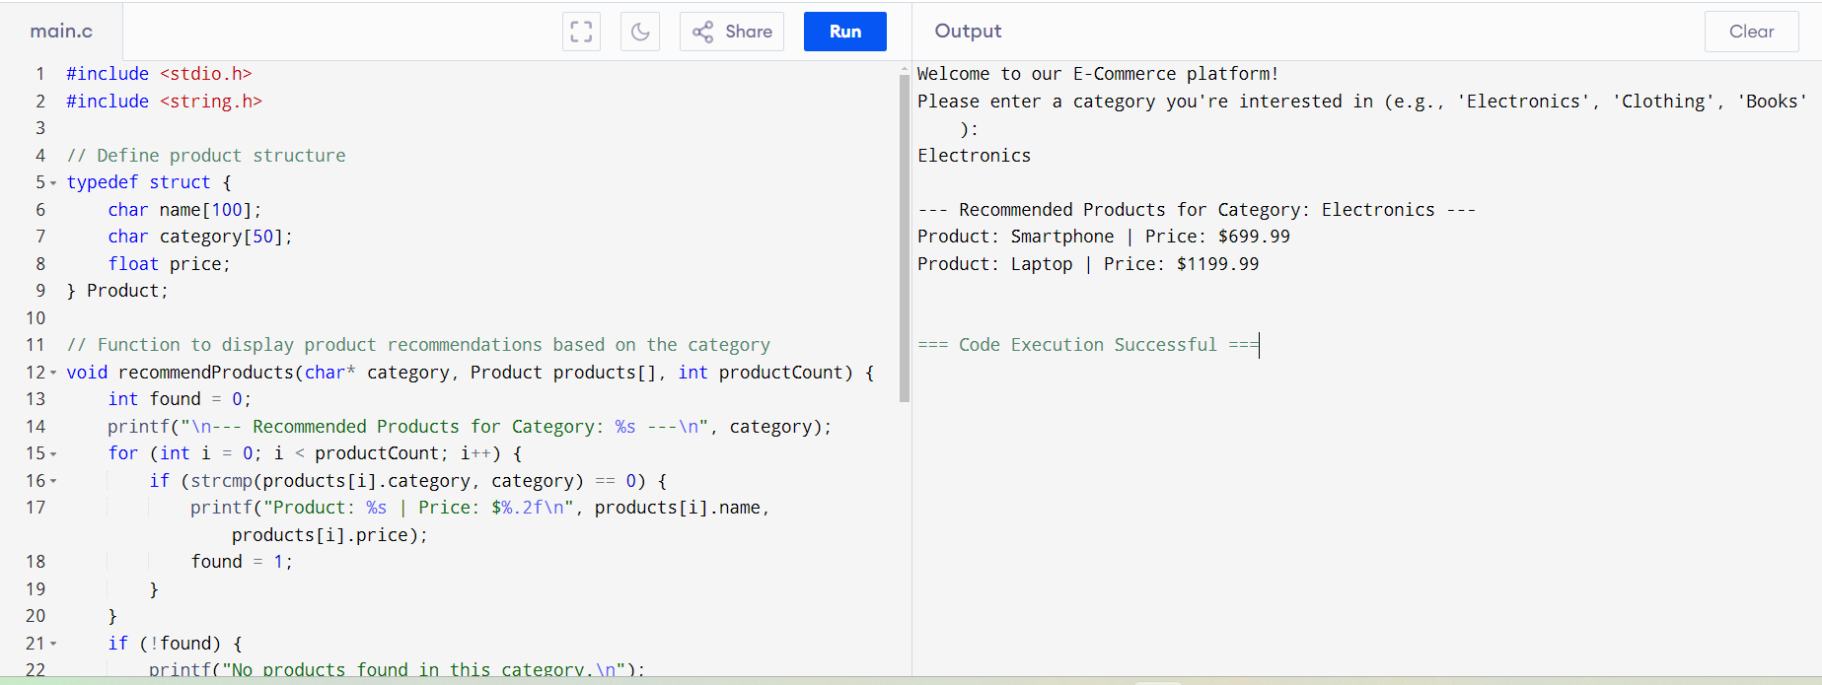
OUTPUT RESULTS:

Slide 8
CODE IMPLEMENTATION:
User-Friendly Interface
Responsive Design: Optimized for all devices (mobile, tablet, desktop).
Intuitive Navigation: Easy search, filters, and categories for seamless browsing.
Clear Product Pages: High-quality images, descriptions, and reviews.
AI Bot for Customer Assistance
NLP-Based Interaction: Understands and responds to customer queries.
Real-Time Support: Provides answers, product recommendations, and order inquiries.
Context-Aware: Personalized responses based on past interactions.
Customer Account Management
Account Creation & Preferences: Easy sign-up, order history, and personalized preferences.
Order History Access: Quick reorder and track past purchases.
Feedback Mechanism
Ratings & Reviews: Collect customer feedback on products and bot interactions.
Surveys: Evaluate AI bot performance and gather improvement insights.

Slide 9
ENGINEERING STANDARDS:
Basic Programming Standards
Code Quality:
Keep it DRY (Don’t Repeat Yourself): Avoid code duplication by creating reusable components, modules, or functions.
Single Responsibility Principle (SRP): Ensure each function or class has one responsibility.
Avoid Hardcoding: Use environment variables for sensitive data (e.g., API keys, database credentials) instead of hardcoding values.
Versioning and Release Management:
Use semantic versioning (Sem Ver) to manage project releases (e.g., 1.0.0, 1.1.0, 2.0.0).
Maintain a changelog to document changes between versions.
Write README files with setup instructions, development guidelines, and API documentation.
Use inline comments to explain complex logic.
Software Engineering Standards
Project Management:
Follow Agile Scrum or Kanban methodology with weekly sprints to deliver incremental updates and feature releases.
Use tools like Jira or Trello for task management.
Version Control and Collaboration:
Maintain all code in Git repositories (e.g., GitHub, GitLab, Bitbucket).
Enforce branching strategies (e.g., Gitflow) for organized development and release management.
Code Reviews and Pair Programming:
Ensure all code is peer-reviewed before merging into the main branch to improve code quality.
Use pair programming to solve complex problems and improve collaboration between developers.
Continuous Integration/Continuous Deployment (CI/CD):
Set up CI/CD pipelines to automate testing, building, and deployment processes. Tools like Jenkins, GitHub Actions, or GitLab CI can help automate the workflow.
Ensure automated unit tests, integration tests, and deployment on staging before production releases.
3 Documentation:
.

Slide 10
FUTURE SCOPE:
Voice-Based Shopping: Integrate voice recognition for product search and purchases.
Augmented Reality (AR): Enable users to visualize products (e.g., furniture, clothing) in real life. Multi-Channel Integration: Expand to multiple retail channels (social media, apps) to boost customer reach. Enhanced Personalization: Use deep learning to improve product recommendations for more personalized experiences. AI-driven Recommendations:
The AI bot can provide increasingly accurate and personalized product recommendations based on individual browsing behavior, past purchases, and preferences. Dynamic Content: The site could evolve to dynamically adjust content, offers, and even layout based on a customer’s behavior and data, enhancing engagement and conversion rates.

Slide 11
CONCLUSION:
The development of a customer-focused e-commerce site powered by an AI chatbot presents a significant opportunity to enhance the online shopping experience. By leveraging AI technology to personalize recommendations, provide real-time support, and proactively engage customers, businesses can drive conversions, increase customer satisfaction, and gain a competitive edge in the ever-evolving e-commerce landscape. The future holds immense potential for further advancements in AI-powered e-commerce solutions, paving the way for even more personalized and engaging shopping experiences.

Slide 12
Thank you!!!

